Slide 1
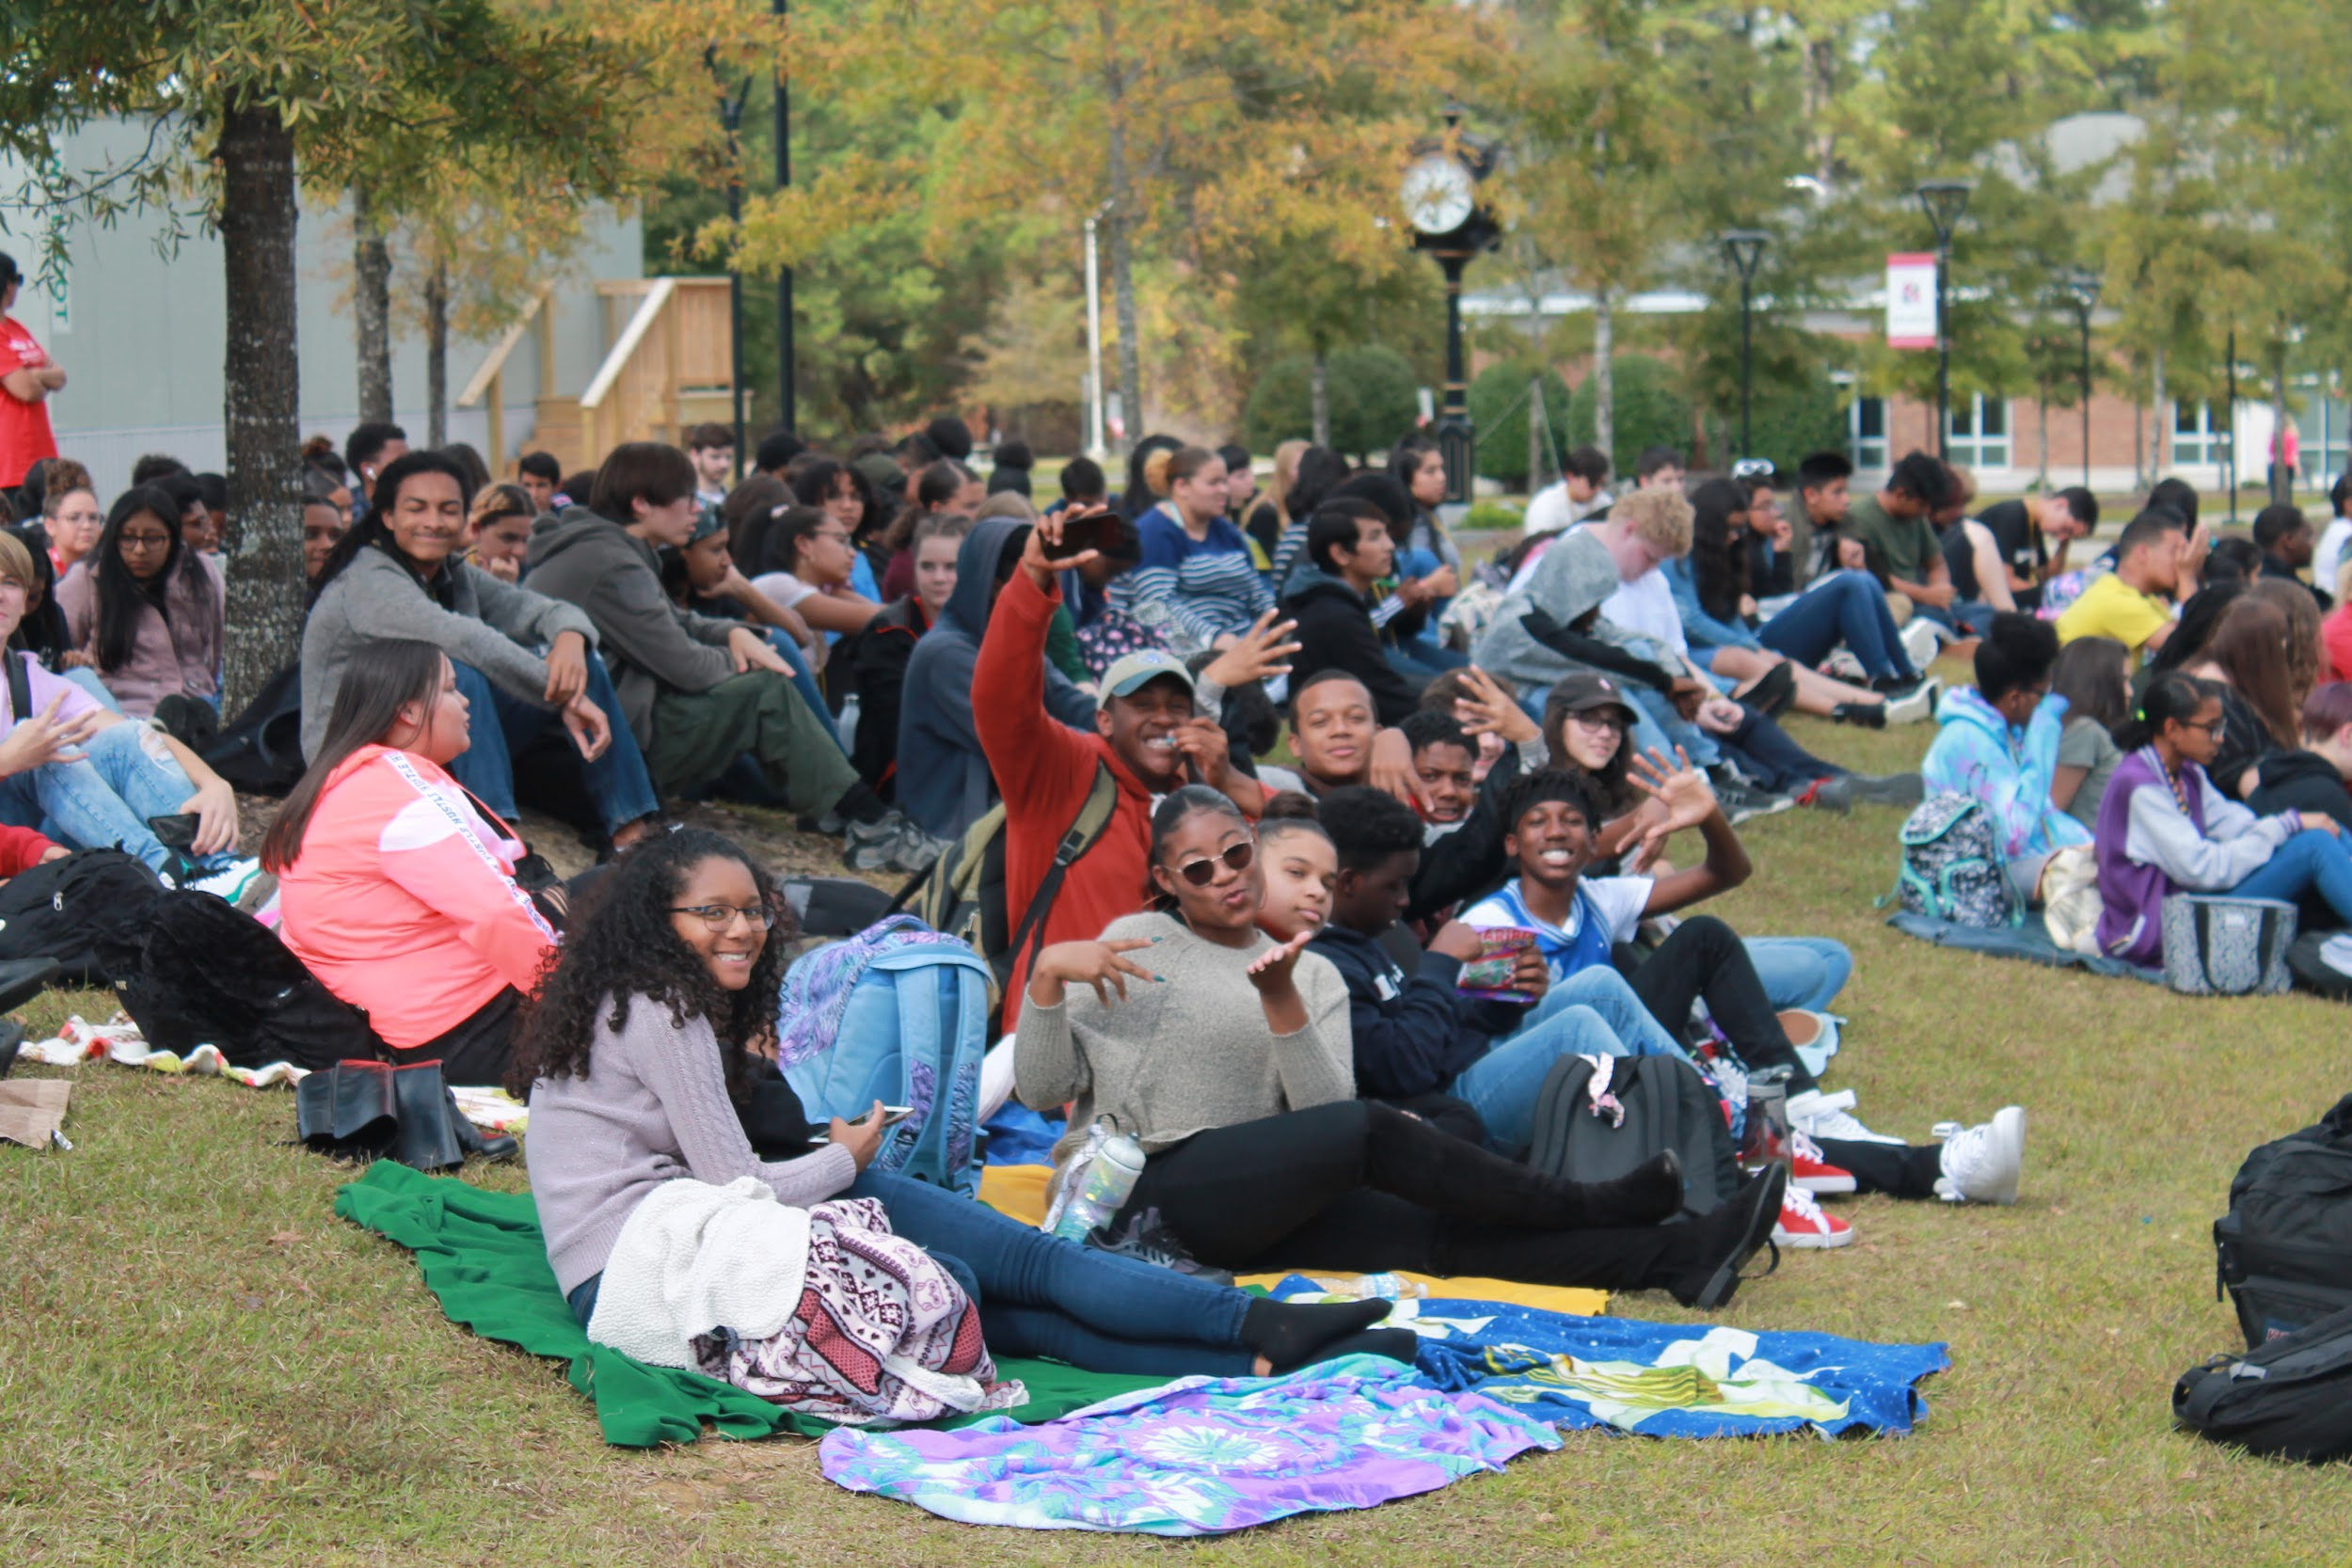
SANDHOKE EARLY COLLEGE HIGH SCHOOL
Introducing

Slide 2
Vision: SandHoke Early College High School will be a school of excellence in providing every student equal and equitable access to rigorous and high expectations course work.
Mission: is to be a school of excellence by providing every student a learning environment of high expectations, innovative and personalized approach to succeed in a rigorous and relevant program of study strategically and purposefully designed to prepare every student for college and career and life ready.

Slide 3
WHY SHEC?
Students can earn their high school diploma and an associate degree.
While we continue to grow (430 +) and feel the constraints of space, our classes average 20 or less.
SH is innovative in its approach creates a more personalized learning environment: Our Focus is developing Academic behaviors and skills for maximum learning experience.
What is the real difference between SH and HH?
HHS provides college courses under the CCP; Students can not start college classes until 11th grade and must enroll in UGETS courses.
Population size.
2000. 30+ students per class.
Bound by traditions.

Slide 4
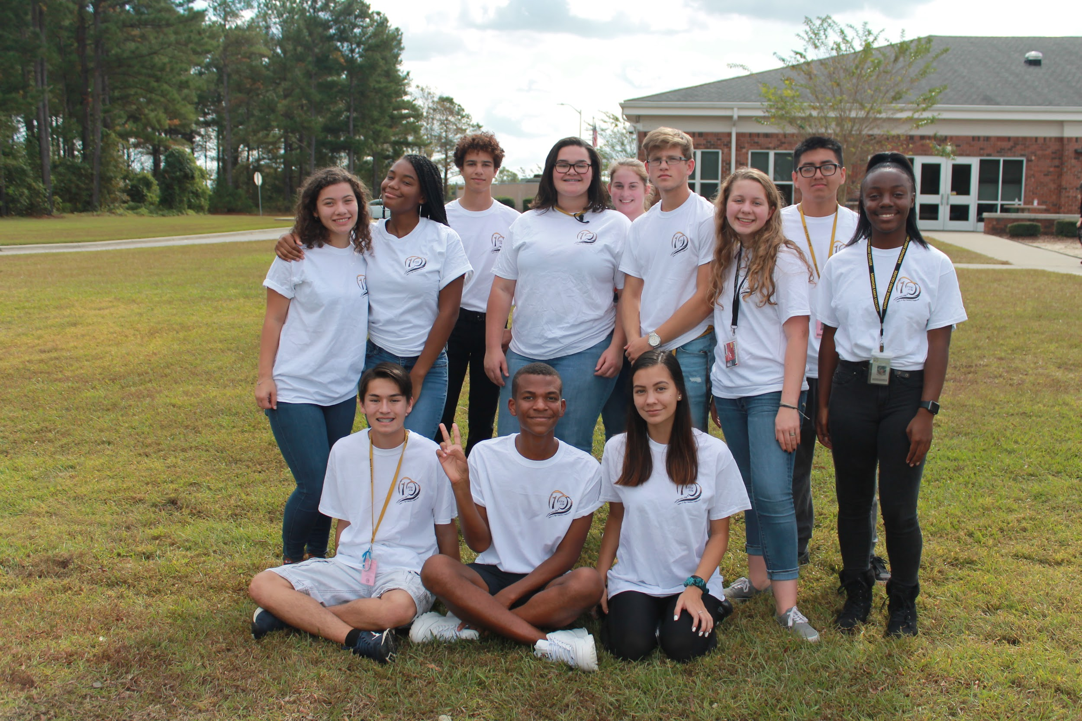
Students engage in authentic learning everyday: Collaborating/networking, presenting, writing, reading, questioning and classroom talking. All part of developing literacy skills in all content.
Notes:
This template can be used as a starter file for a photo album.

Slide 5
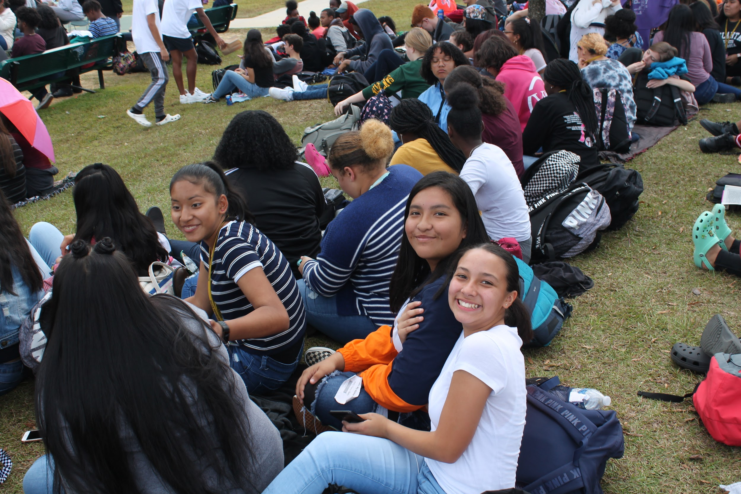
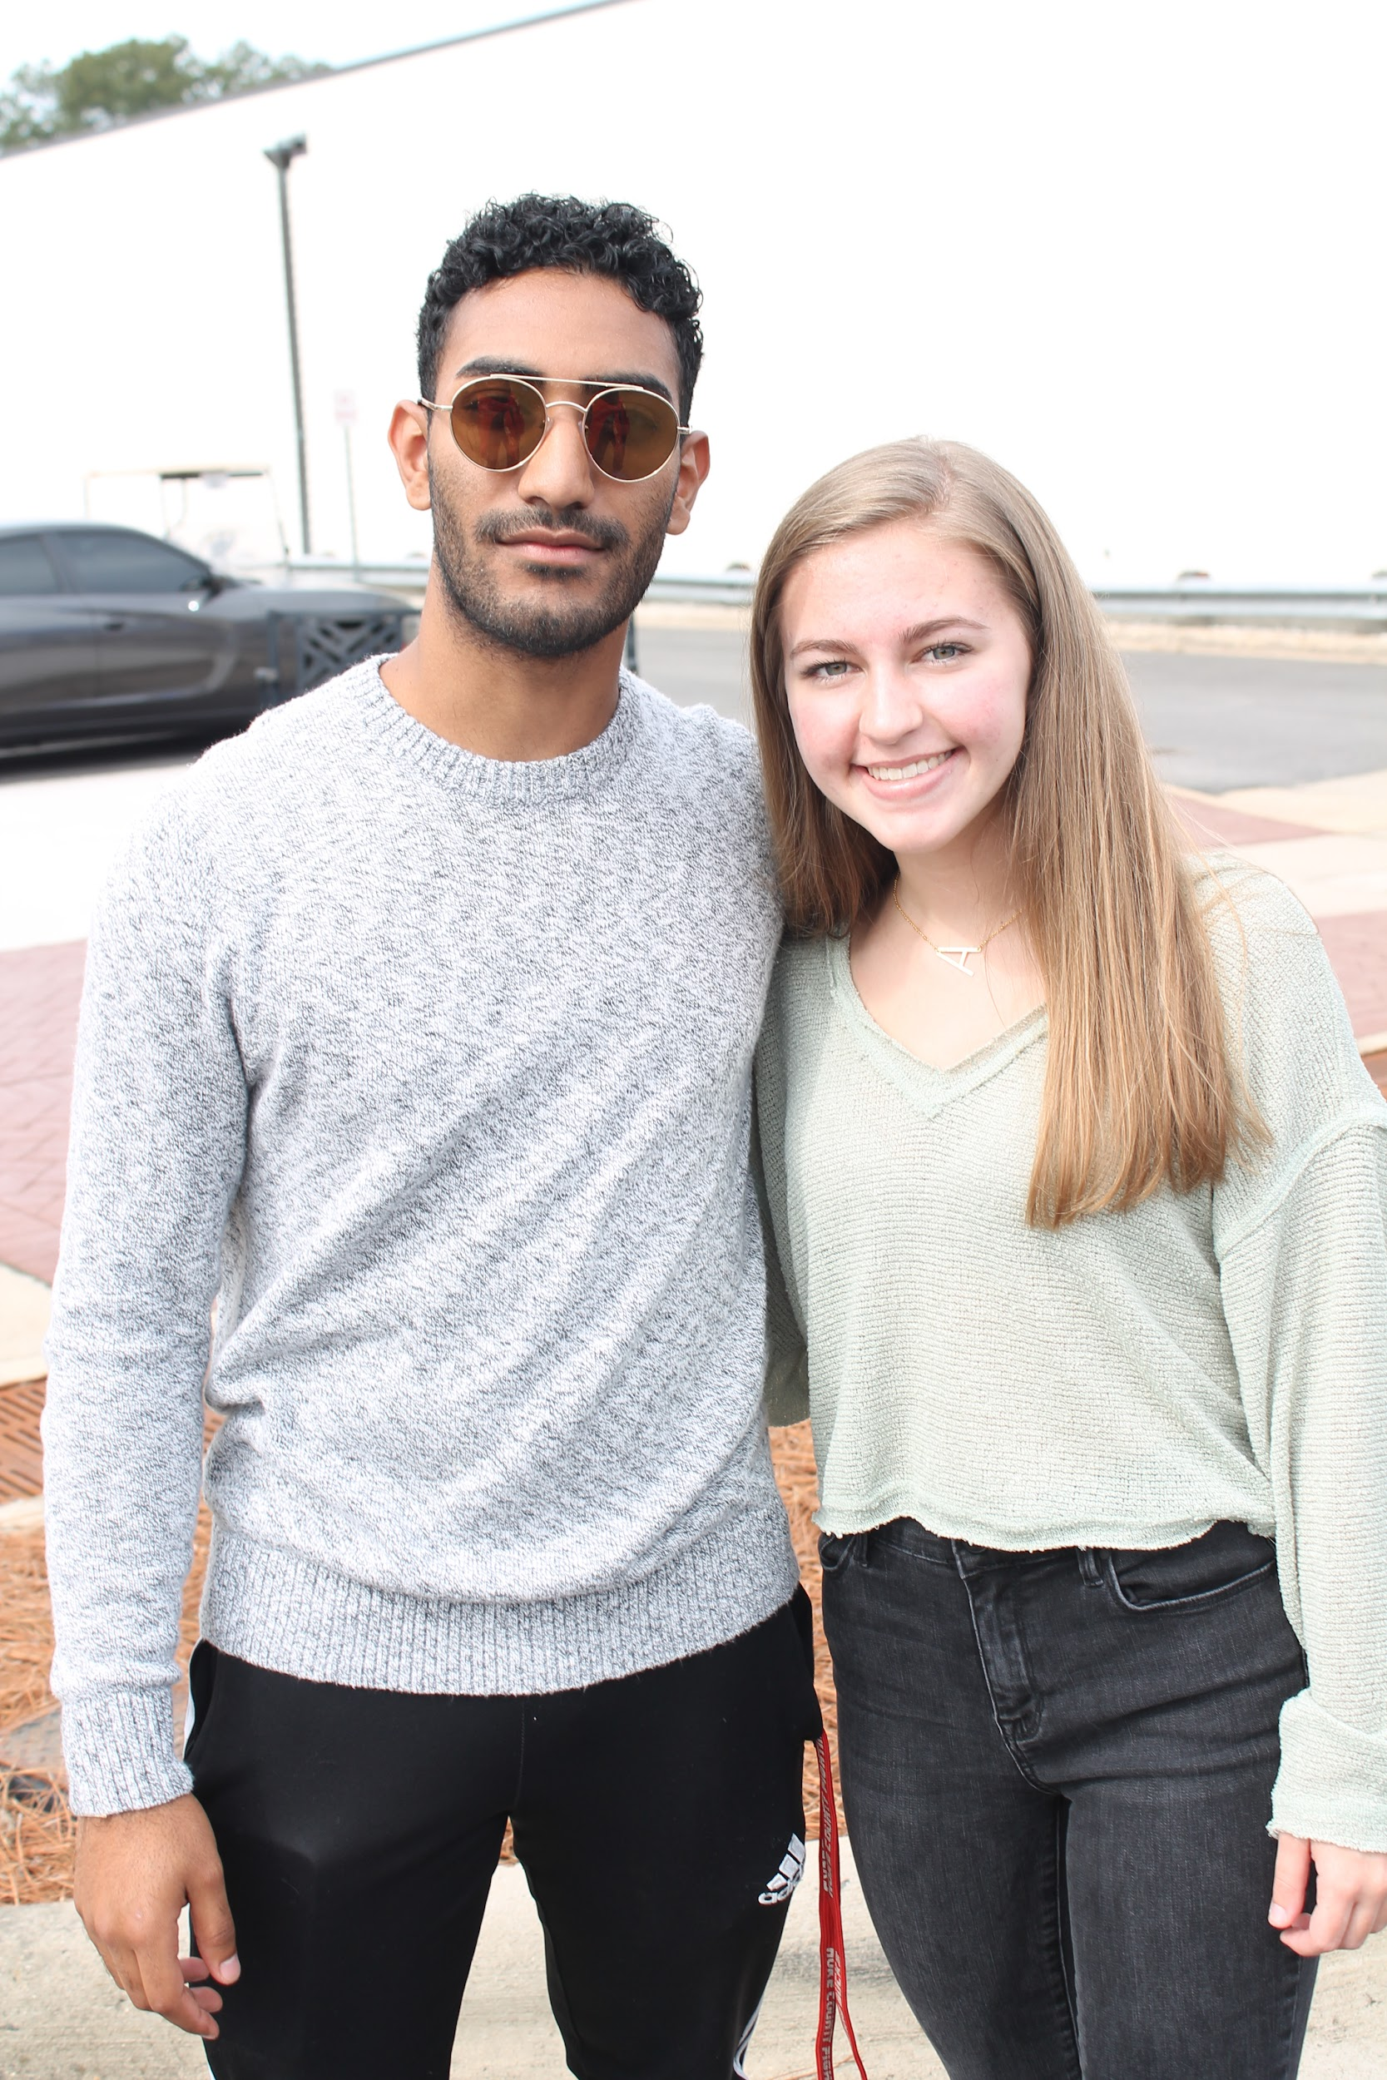
21st century world requires:
A knowledge generation
A mindset of inquiry
Culturally diverse students
Excited learners
Motivated learners
Personal best attitude
Critical thinkers/problem solvers
Personable and thoughtful
Communicators

Slide 6
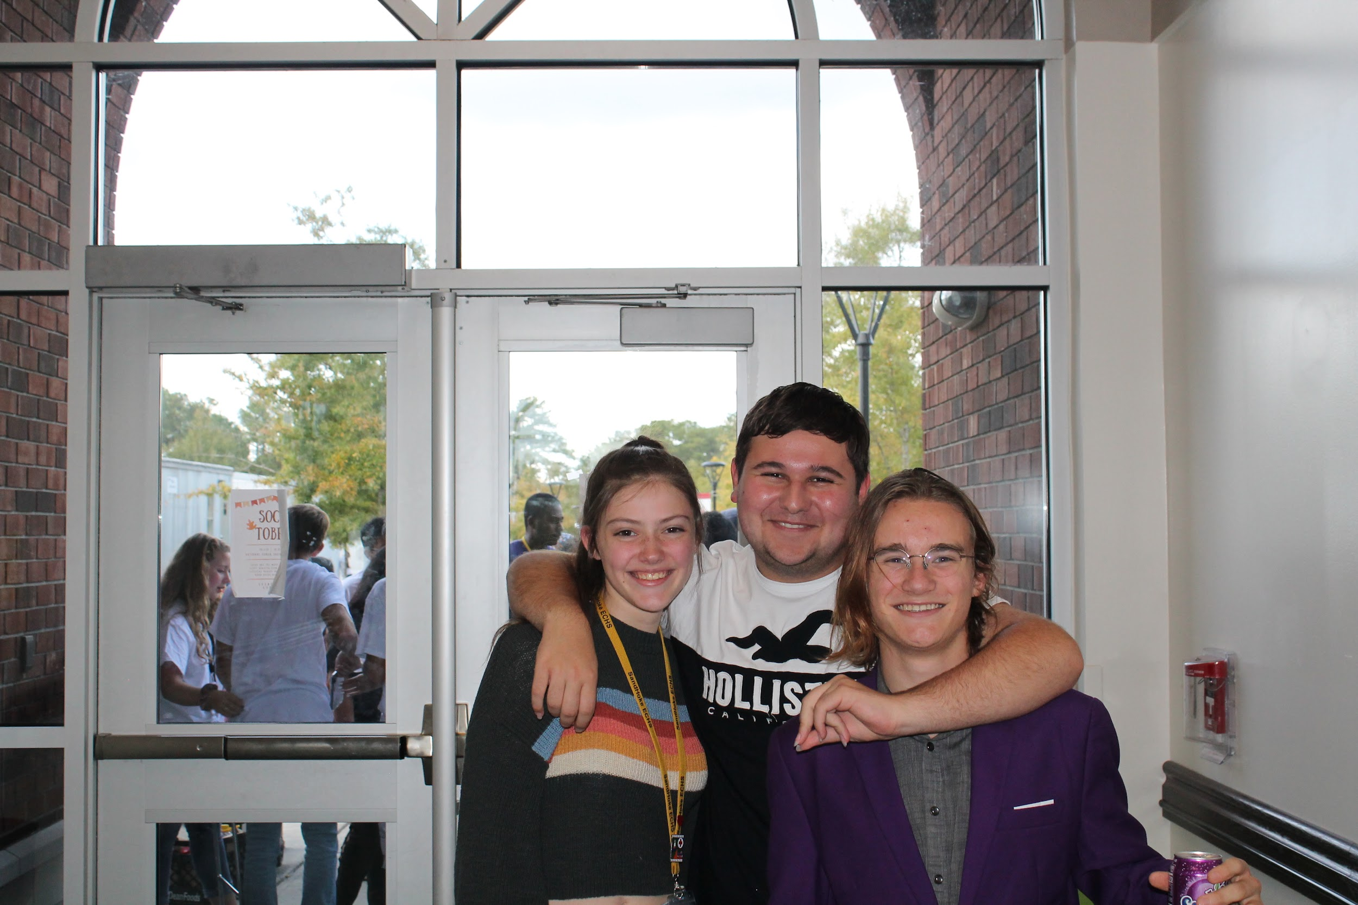
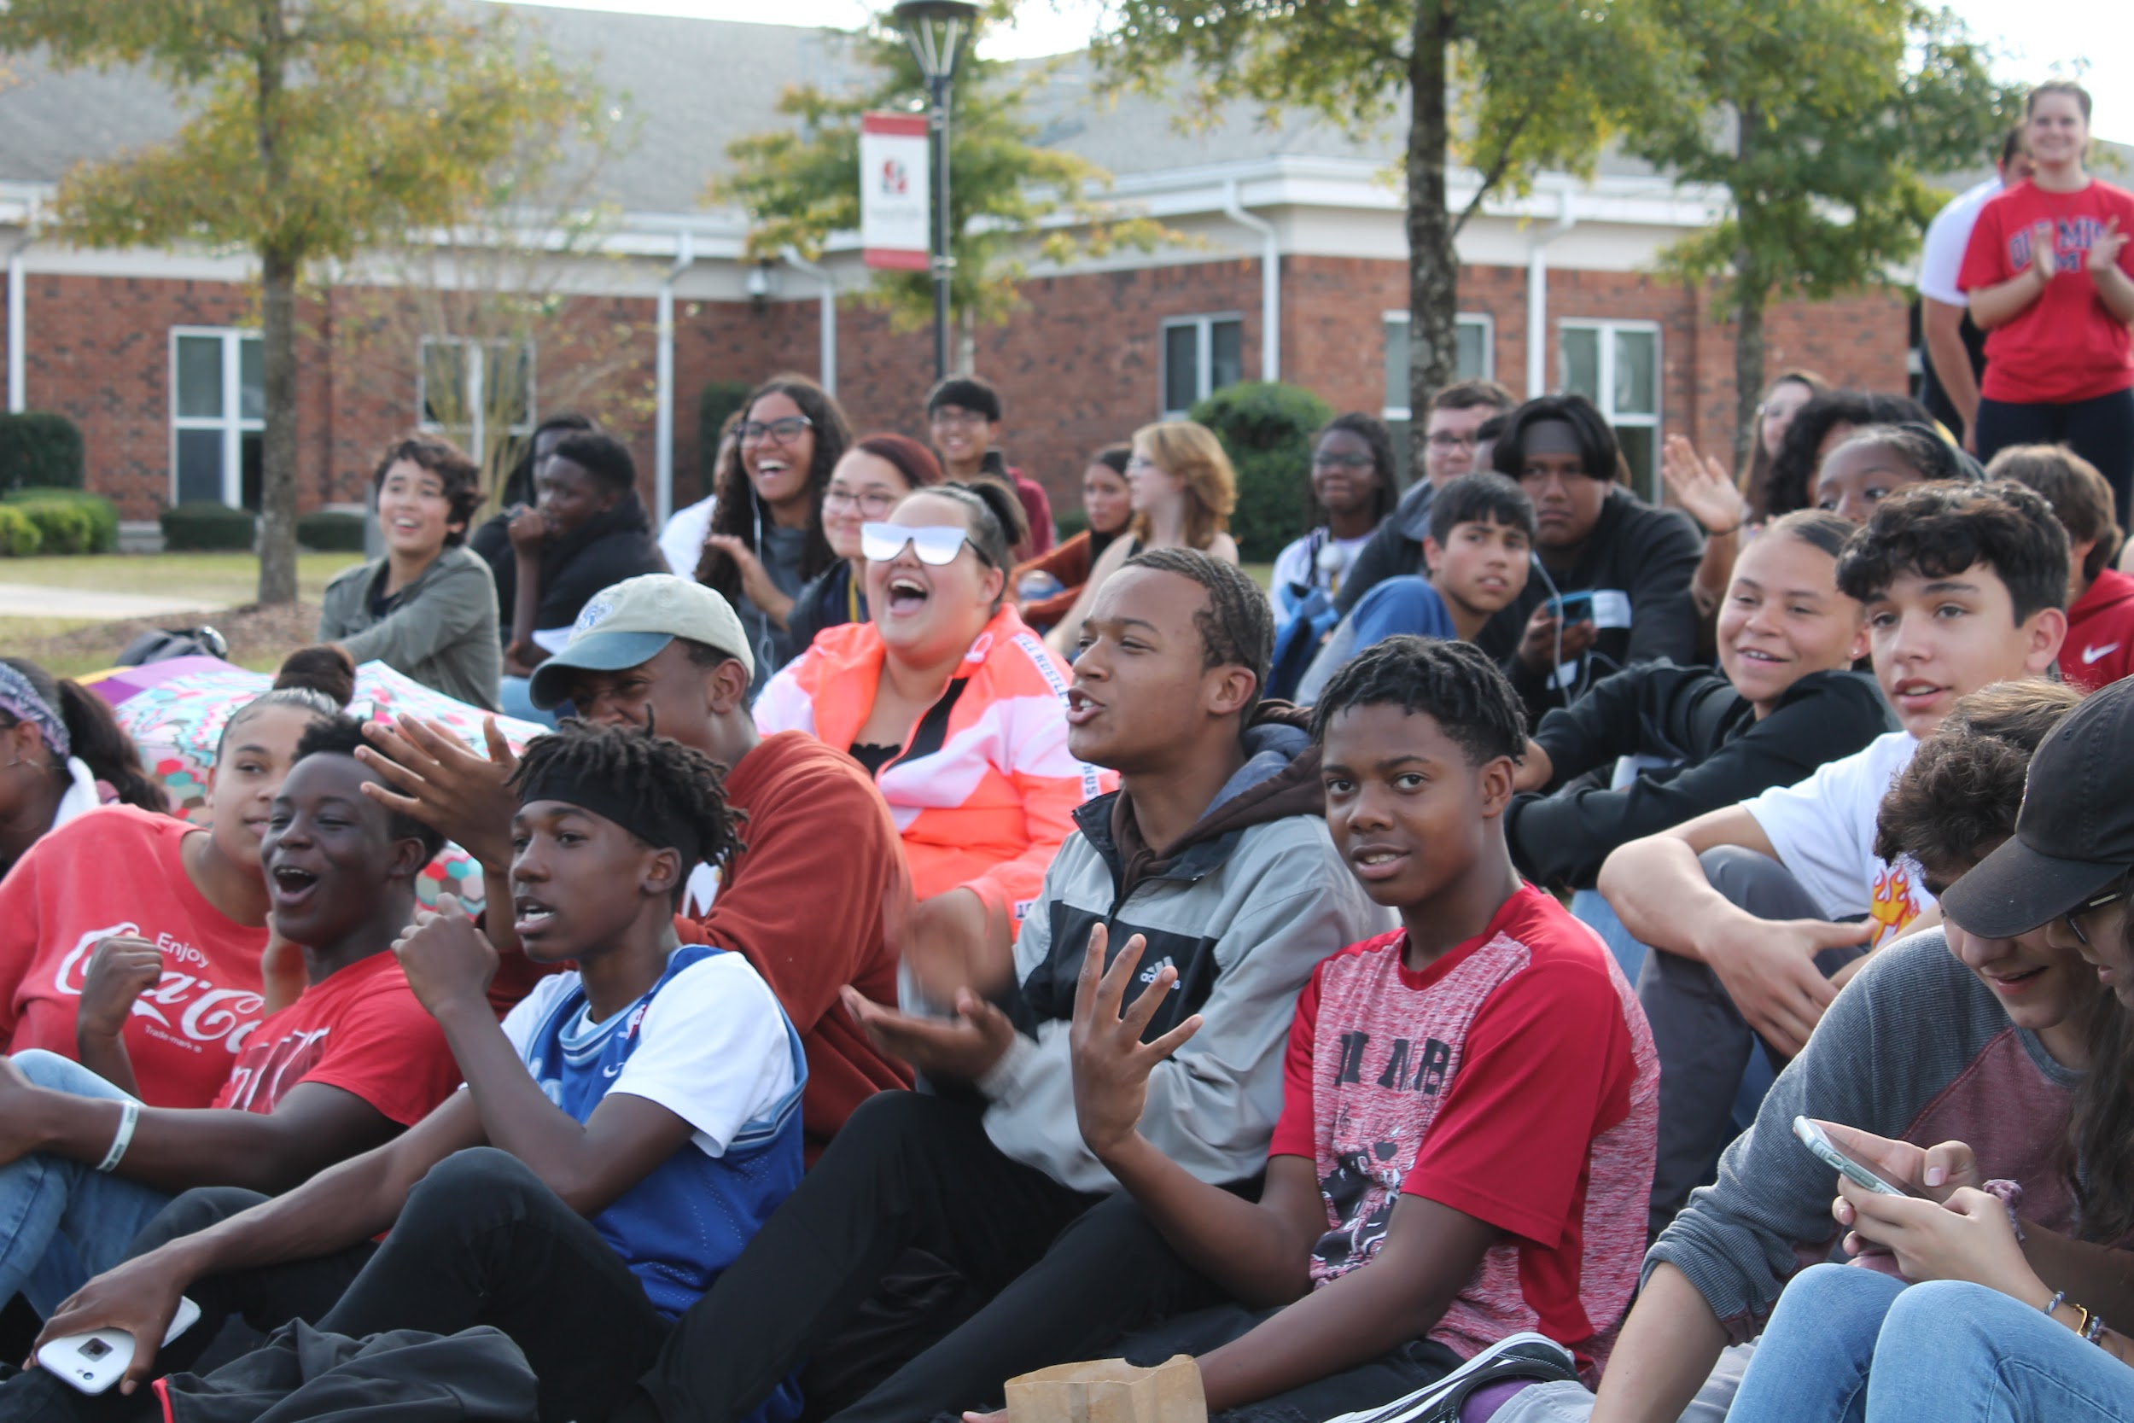
We focus on student growth; both academic skills and behaviors
Students are challenged to move out of their comfort zone through the rigorous coursework in each classroom. They are given immediate feedback on their work. They must learn how to think critically, problem solve and create new knowledge. These are essential college and career ready skills.

Slide 7
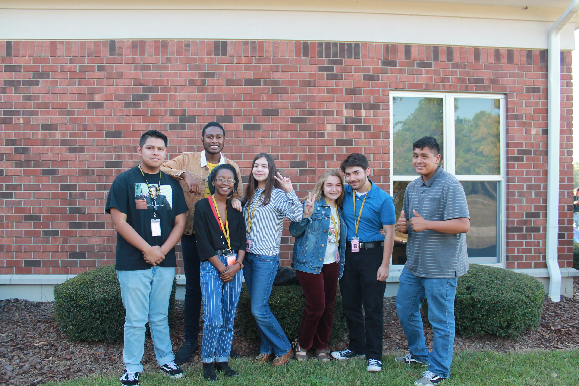
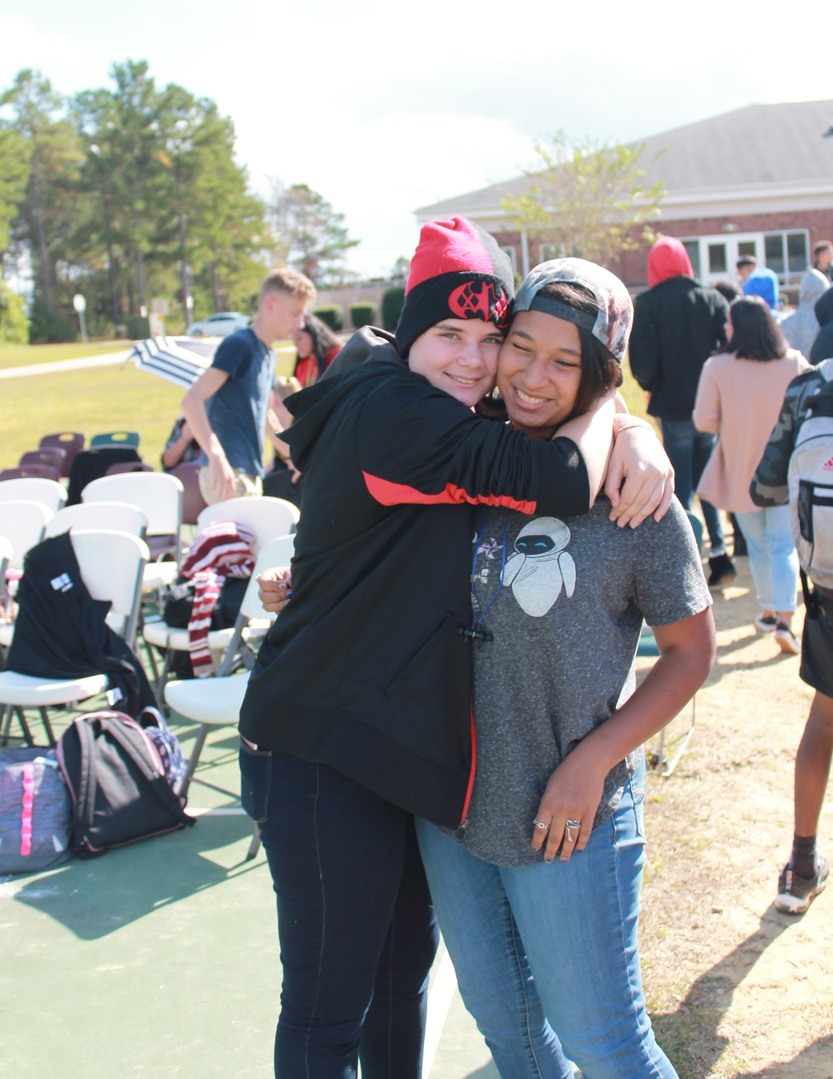
We focus on developing Students Social Emotional Intelligence. Metacognition is essential to academic success. Self-Efficacy is essential to Academic success. Self Motivation is the foundation to life success.

Slide 8
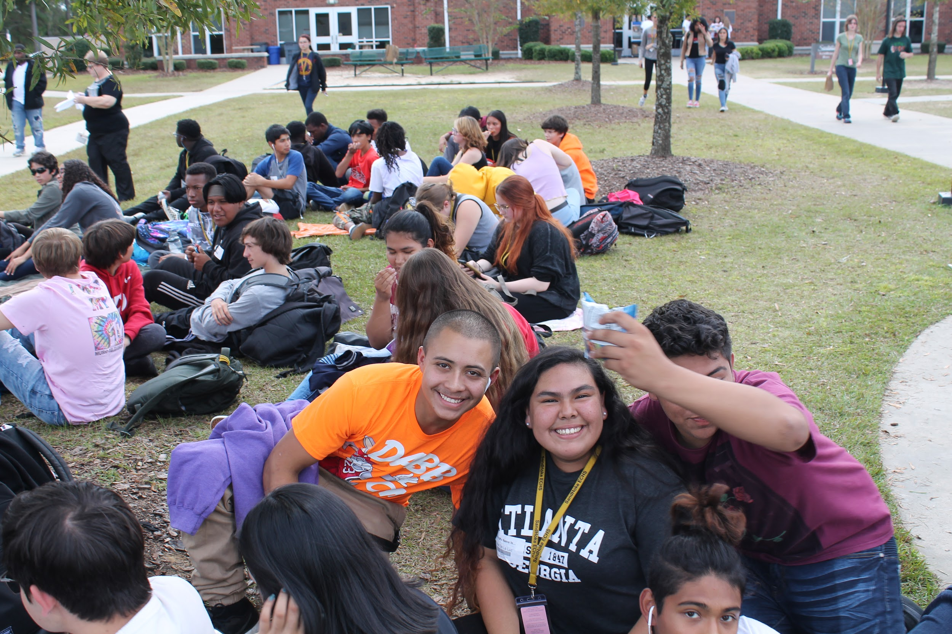
Students must learn to collaborate, to complete and submit quality work on time, and demonstrate academic integrity. These are essential college ready behaviors.

Slide 9
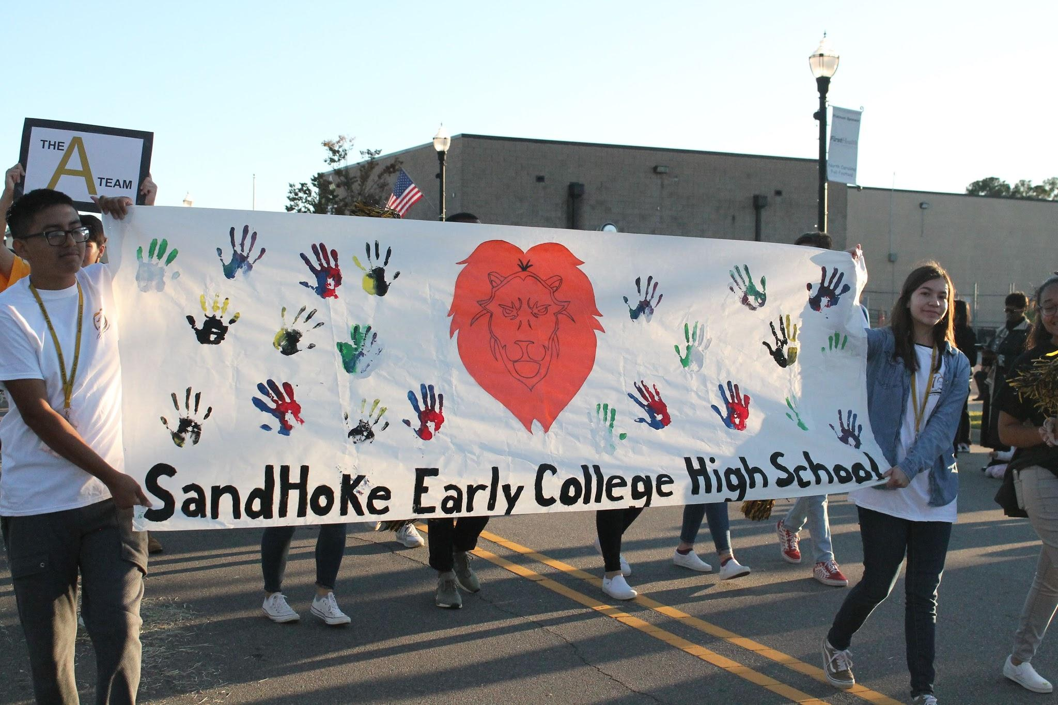
Bragging Rights
2018-19 “A” School
SPG
Overall:
School Performance score 90
Growth 89.6%: Assessment 89.6%
Exceeded growth 2018-19: (4th consecutive year)
Students proficiency: English 2-89.2%
Biology <95%
MATH STUNK!!
ACT Composite Scores: 2018-19
Juniors tested 22 versus state expectation of 17 and state average of 19
GRADUATION RATE: 95%
College readiness: 68% GLP 79%
ACT CR Benchmark: 95%
Math rigor completion: 95%
Fall 2019:
BIO 81%
Math 3 89%
ENG 2...scores return August 2020
Annual and biannual academic recognitions are part of how we connect to students. We also recognize our students for College Ready and High School Ready Student of the Month/Quarter.
Every Staff member has a degree!
1 PHD 2 Ed.D,1 ED.S
2 Masters
13 BA / BS
2 ASSOCIATES

Slide 10
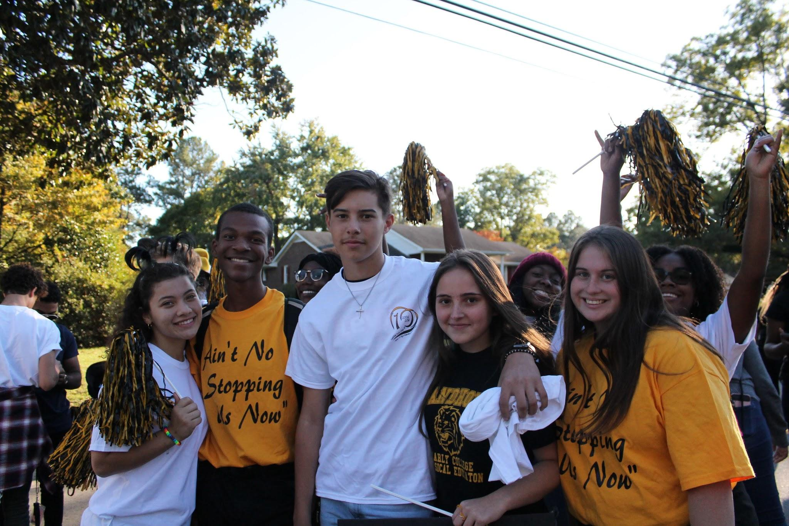

“A” is ACCELERATING
STUDENTS TO SUCCESS!
Academic Supports are in place:
Advisory
Seminar
SMART LUNCH
Tutoring
MTSS
P.A.S.S. events
PLCs/TLCs (PDs)

Slide 11
SandHoke Early College?
Is a public high school on a community college satellite campus
Is a five year program
grades 9-13: can complete in 4 or 4.5 years
College courses and textbooks are free
College courses enrollment begins in10th grade if ready!
High school courses taught by highly qualified school teachers
College courses taught by college instructors:1 SH instructor facilitates college courses ENG 112
Students transition to SCC main campus in 4th year if CR is demonstrated

Slide 12
Typical COURSE Accelerated path:
Year | FALL | SPRING | CREDITS
1st year/freshman | ESSENTIAL MATH H/PE Adv Inq FOREIGN LANGUAGE 1 JROTC/BAND | Math II ES ENG 1 FOREIGN LANGUAGE 2 JROTC/BAND | 8
2nd year | Math 3, ENG 2 WH COLLEGE CLASSES (1) SOC 210 JROTC/BAND | ENG 3, CHEM, AMH 2 COLLEGE CLASSES TBD | earn up to 9 HS CREDITS and/or 9-10 COLLEGE CREDITS
3rd year | BIO SIE COLLEGE CLASSES (3)=9 CREDITS | ENG 4 & CIVICS COLLEGE CLASSES (this is where FL must be completed) (4) = 12 CREDITS | 5 HS CREDITS 12-15 COLLEGE CREDITS
4TH YEAR | COLLEGE CLASSES 15 CREDITS | COLLEGE CLASSES 15 CREDITS | 30 CREDITS

Slide 13
How to Become a SandHoke Student
Complete the application which is available online at our website.
Application closes: March 11, 2022 @midnight
Video and Essay requirements for all applicants opens March 14th
Submission due date is March Dates available: March 25, 2022 using the drop box provided on website
Parents may assist their students in completing this task.
Candidates are selected based on a compilation score in three categories: Potential Academic Skills (EOG/course performance), historical academic performance and attendance and students’ essay and video scores.
Remember all candidates must have completed Math 1/EOC or another assessment prior to start Bridge (August 3rd).

Slide 14
How to Become a SandHoke Student
Applicants selected are notified by letter. The middle school is also provided a list of selected students.
With the letter is a contract; it must be signed and returned by the due date. If not, seat will be offered to a student on waiting list.
All entering 9th graders are required to attend Freshman Bridge on August 3-5th
We request parents attend a bridge program: Dates TBD.

Slide 15
Program Completion
Associate of Art 60-61 credits
Associate of Science 60-64 credits
Associate of Applied Science 70+ credits
An accelerated student can complete Associate degree in 4 years.
Average pace is completion between 4.5-5 years.
All that matters is a two year degree or 60+ credits are completed and transferrable to 4-year UNC colleges.

Slide 16
Transportation
Transportation is provided for the entire enrollment in SandHoke Early College by the Hoke County Public School System. This includes high school and college campus.
Shuttle service available in the afternoons to Hoke County High School
  Sports
  Band
  JROTC
  Driver’s Ed
  Must have verification to go to Hoke High
    Intent to play form
    Roster from Band/coaches
    Driver’s Ed roster

Slide 17
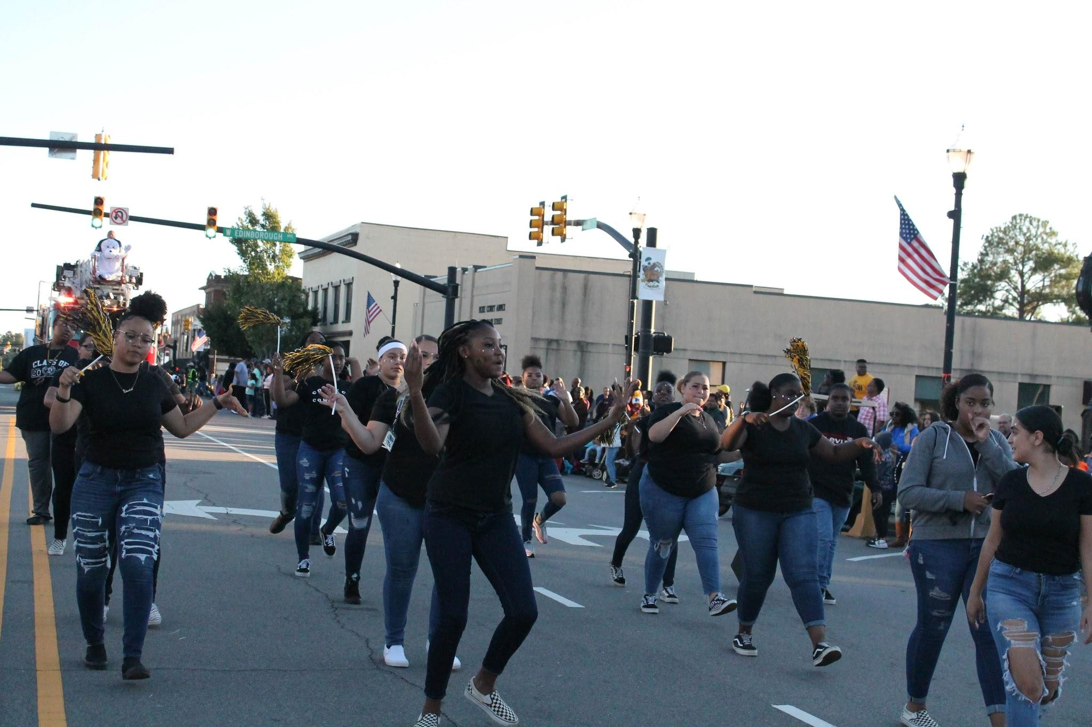
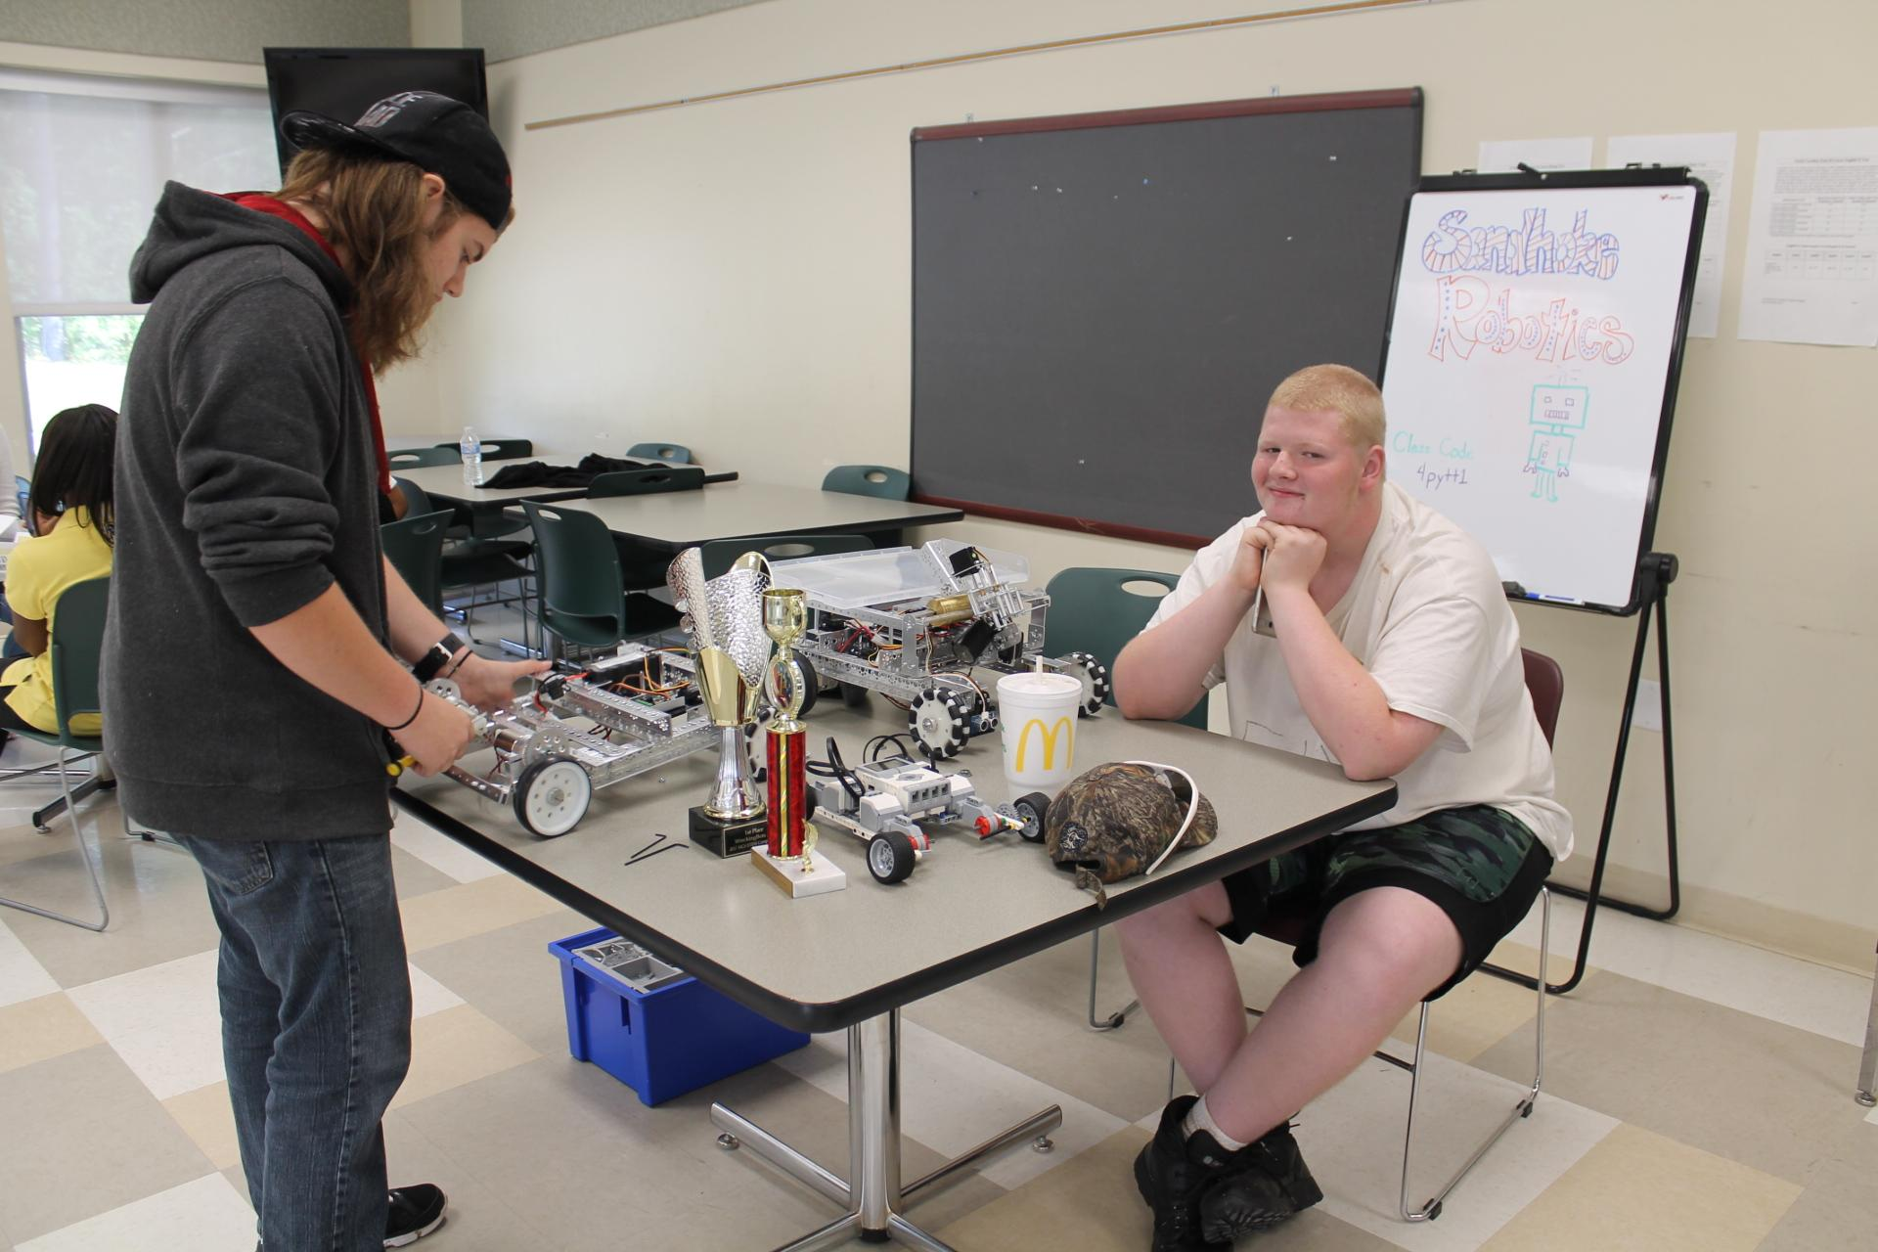
Clubs and Activities at SandHoke
Speech and Debate Team
Battle of the Books
Student Advisory Committee (SAC)
Student-Led After School Clubs
Ginger-Bread Tree/community volunteering
Robotics/STEM

Slide 18
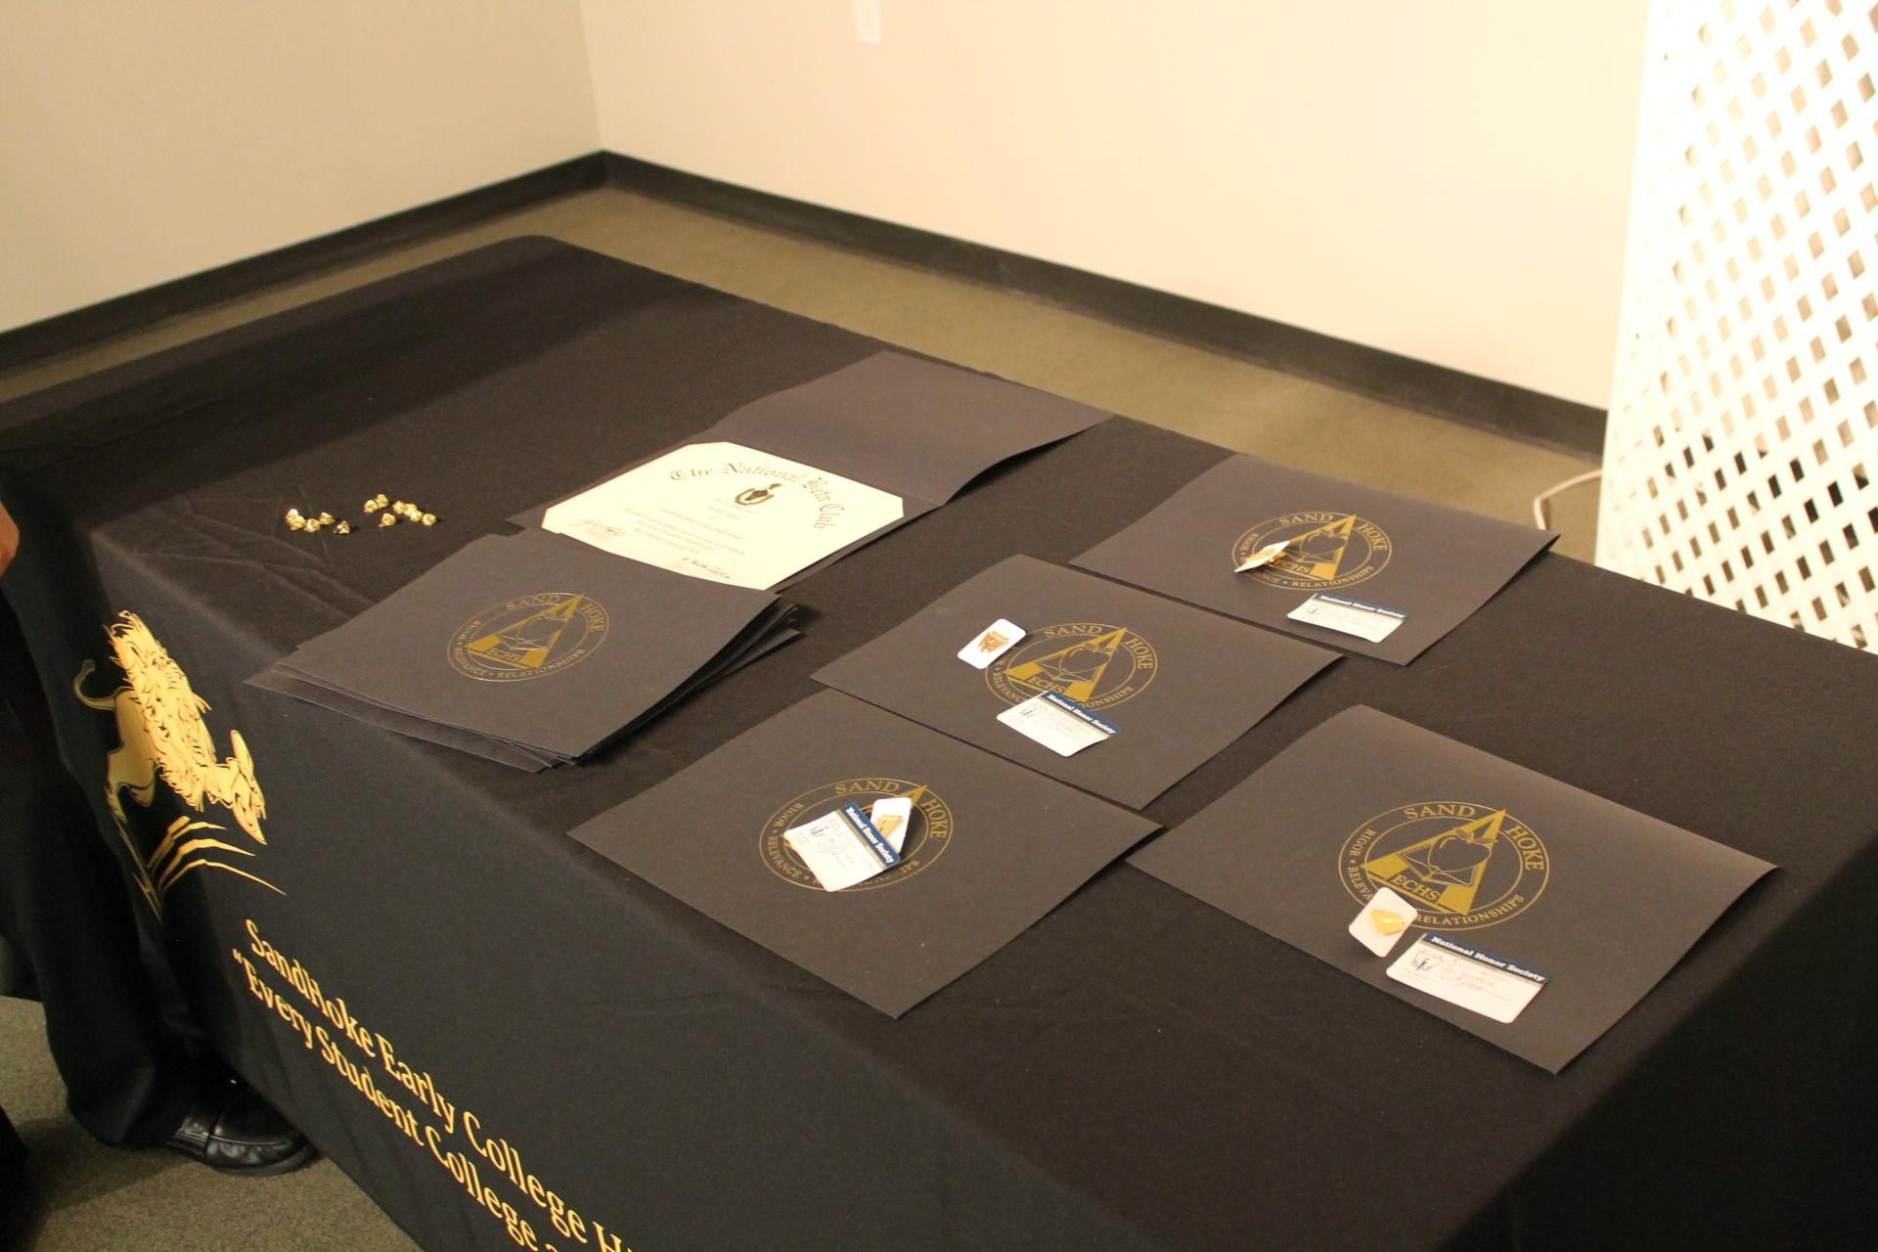
Honor Societies
National Honor Society
Beta Club
Science National Honor Society
Mu Alpha Theta Honor Society (math)
Rho Kappa National Social Studies Honor Society

Slide 19
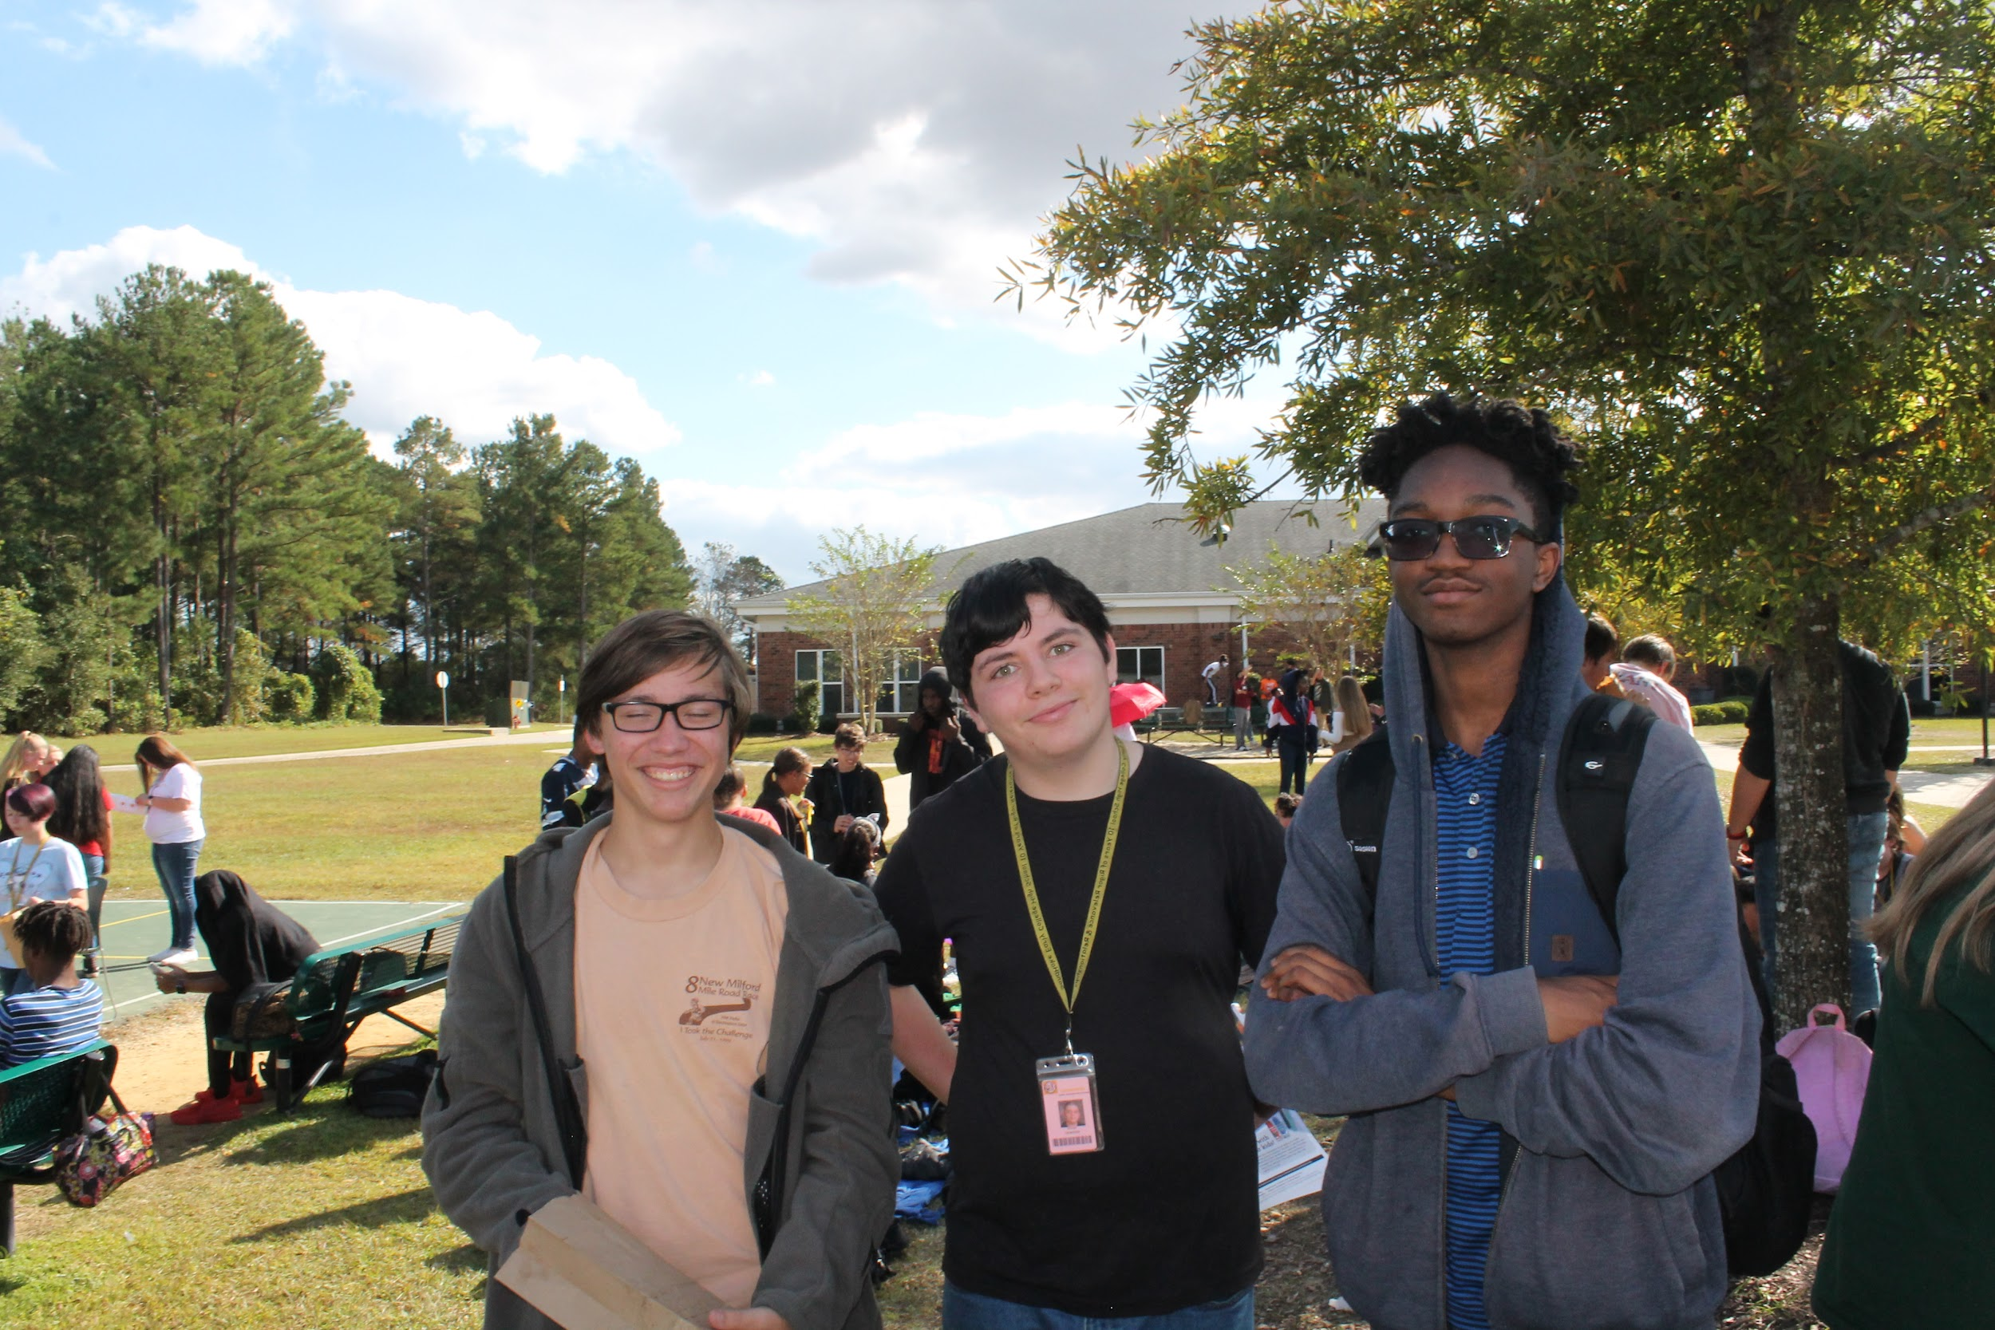
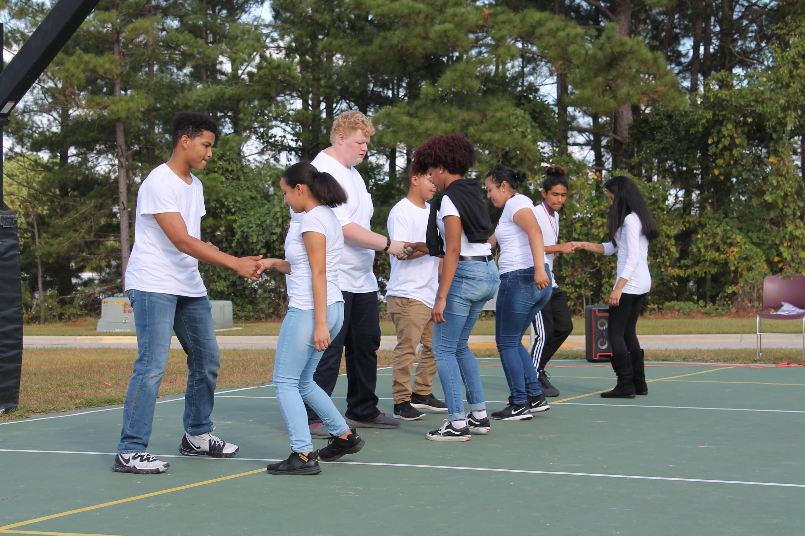
Your student will experience a change in his or her academic perspective.
If your student embraces his or her academic experience, sees it as an opportunity versus an obligation, he or she will graduate with a high school diploma and an associate degree within 4, 4.5 or 5 years. Students are in control of their outcome.

Slide 20
Q & A

